Slide 1
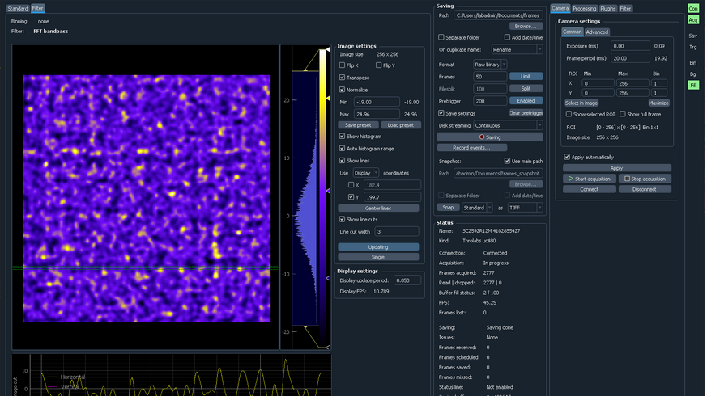
MOTOR CONTROLS
HERE ADD
ACQUISITION

